Slide 1

StudyBuddy
AI-Driven Study Management & Mock-Test Platform
A structured presentation covering Introduction, Aim & Objectives, Database Design, ER Diagram, and Conclusion.
PRESENTED BY: VIVEK PAWAR

Slide 2
Introduction
StudyBuddy is an AI-powered learning management platform designed to help students organize study materials, create notes, take mock tests, and improve learning efficiency. The platform aims to create a centralized environment where students can learn, practice, and monitor their academic performance effectively.
Digital Notebook Management
AI-Assisted Note Generation
Community-Based Learning
Mock Test Creation & Evaluation
Progress Tracking & Analytics
Teacher-Student Interaction

Slide 3
Aim & Objectives
Aim
Student Management
Study Material Management
To develop an AI-powered study management and assessment platform that helps students organize learning resources, improve preparation, and track academic progress.
Maintain student profiles and manage learning activities
Create notebooks and sections; store notes and resources
AI Learning Assistance
Online Assessment
Create mock tests, attempt quizzes and exams, and evaluate student performance
Generate summaries, answer study-related questions, and improve learning efficiency
Progress Tracking
Community Learning
Monitor learning progress and generate performance analytics
Enable group discussions and share notes and study materials

Slide 4
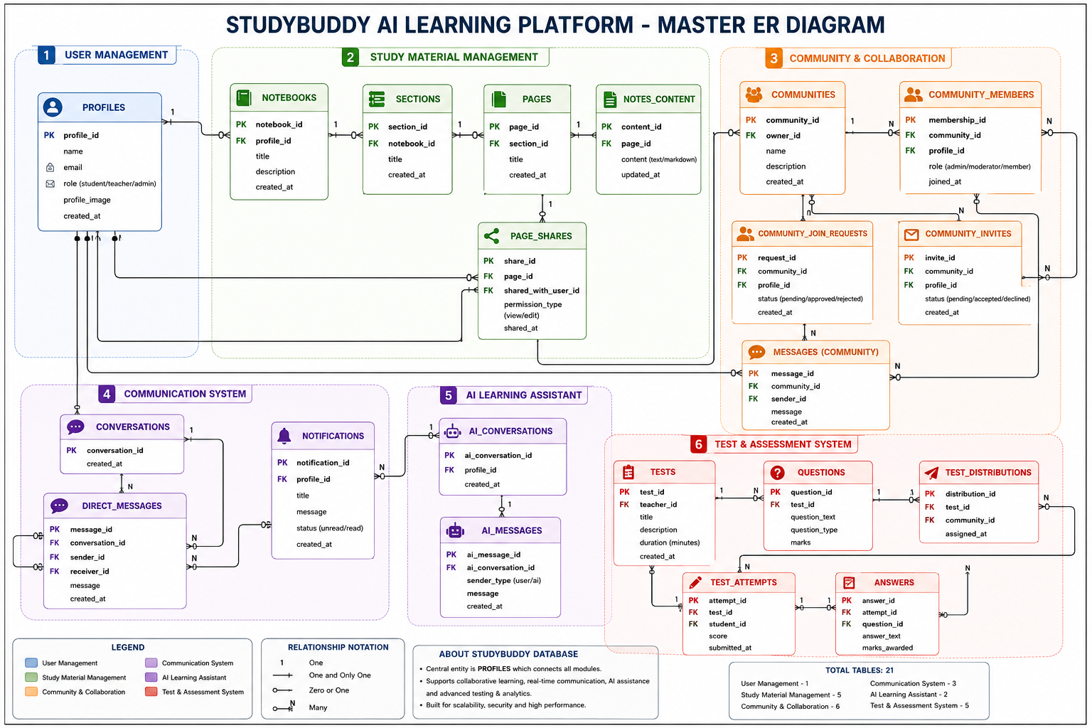

Slide 5

ER Diagram
Main Entities
Key Relationships
One User can create multiple Notebooks
One Notebook contains multiple Sections
User Module
Profiles
One Section contains multiple Pages
One Community contains multiple Members
Study Material Module
One Test contains multiple Questions
One Student can attempt multiple Tests
Notebooks, Sections, Pages, Notes Content
One AI Conversation contains multiple Messages
Community Module
Insert your generated ER Diagram image on this slide.
Communities, Community Members
AI Module
AI Conversations, AI Messages
Assessment Module
Tests, Questions, Test Attempts, Answers

Slide 6
Conclusion
StudyBuddy provides a complete digital learning ecosystem for students and teachers. The system reduces manual efforts, improves learning efficiency, and provides a scalable solution for modern education environments.
Study Material Management
AI-Based Learning Support
Community Collaboration
Online Test Management
Performance Analytics
Future Enhancements
AI-Powered Personalized Learning Paths
Smart Recommendation Engine
Voice-Based AI Assistant
Advanced Analytics Dashboard
Mobile Application Integration

Slide 7

Thank You
StudyBuddy – AI-Driven Study Management & Mock-Test Platform
Presented By
Department
Vivek Pawar
Computer Science & Engineering
Open Floor
Questions & Discussion

Slide 8
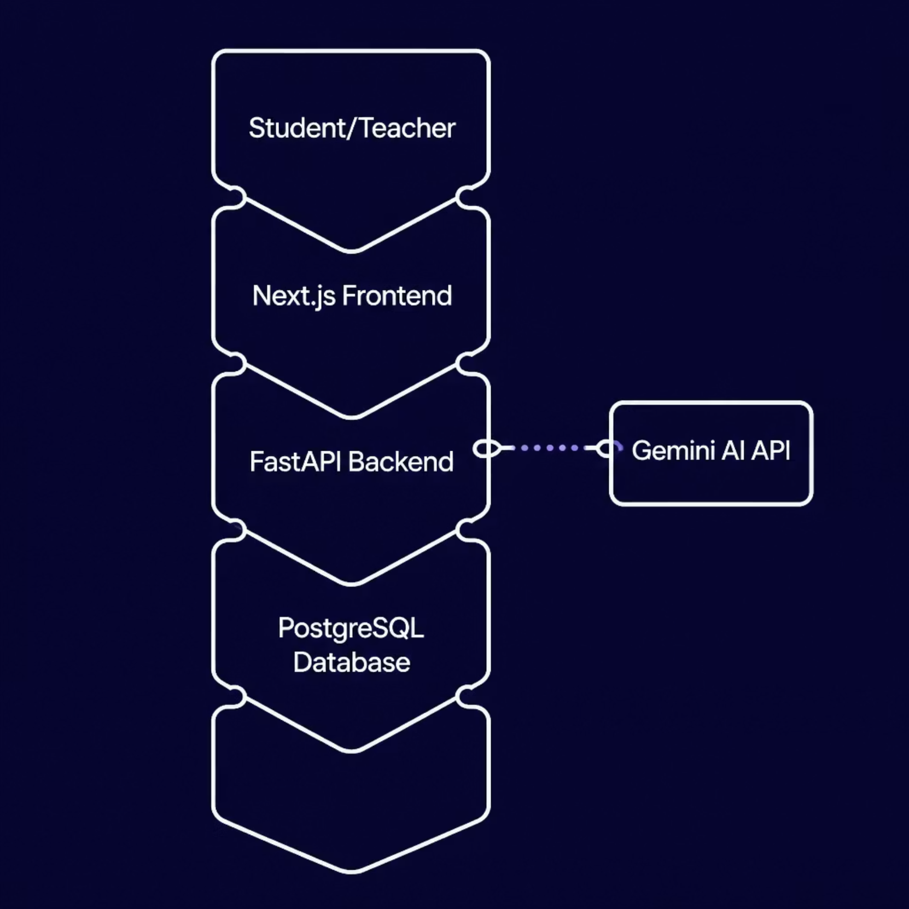
Technology Stack & System Architecture
System Architecture
Technology Stack
Frontend
Backend
Next.js · Tailwind CSS
FastAPI
Database
Auth
PostgreSQL
Firebase Authentication
AI
Infrastructure
Gemini AI API
Redis · Vercel · Render

